Slide 1


AMSAT
FOX+
ENGINEERING
FOX+
Project Status
Review
November 6, 2024
Notes:
FOR OFFICAL USE ONLY

Slide 2
FOX-Plus
Project Status Review
FOX+
I. Introduction
II. Fox-Plus System Overview
III. Structure
IV. Linear Transponder Module (LTM)
V. Electrical Power System (EPS)
VI. Command & Data Handling Software / Firmware
VII. Experimental Payloads
VIII. Pre-flight Testing & Readiness
Conclusion(s)
4

Slide 3
FOX-Plus
Project Status Review
FOX+
I. Introduction – Mission & Objectives
The purpose or mission of Fox-Plus is to continue and augment the success of the original Fox series of AMSAT 1U CubeSats
- to have units “on the shelf” ready to fly experimental payloads
on short notice
4

Slide 4
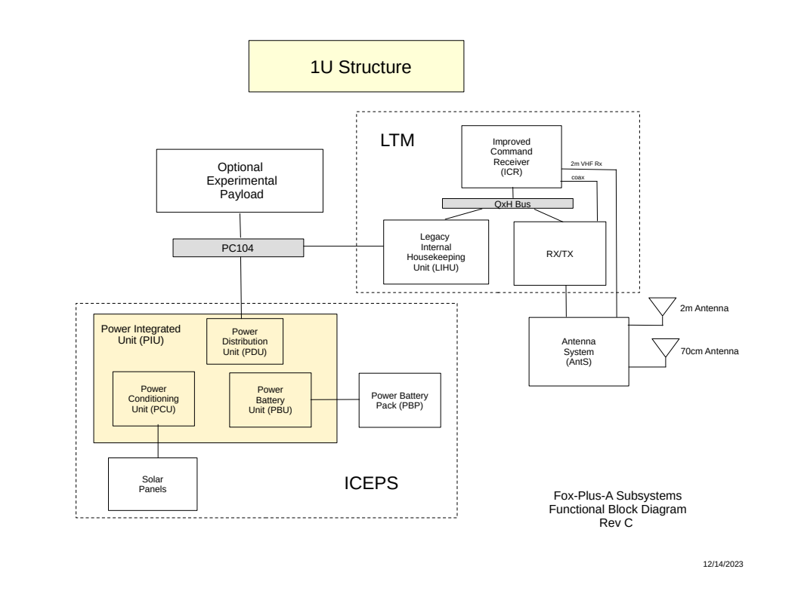
FOX-Plus
Project Status Review
FOX+
II. Fox-Plus System Overview
4

Slide 5
FOX-Plus
Project Status Review
FOX+
II. Fox-Plus Sytem Overview
Documentation:
- Interface Control Document (ICD) DRAFT:
- ICD version 1.0:
4

Slide 6
FOX-Plus
Project Status Review
FOX+
III. Structure
Drawings:
-
4

Slide 7
FOX-Plus
Project Status Review
FOX+
IV. Linear Transponder Module
Consists of three PCB:
1. Fox-Plus IHU (FIHU) based on the Legacy IHU (LIHU)
2. Improved Command Receiver v2.2
3. RXTX v2.2?
4

Slide 8
FOX-Plus
Project Status Review
FOX+
IV. Linear Transponder Module
1. Fox-Plus Internal Housekeeping Unit (FIHU)
- Based on the very successful Legacy IHU (LIHU)
-- for Fox-Plus, FIHU functions as main OBC
- Changes made necessary due to the interface of the ISISPACE EPS
- Also interface to ISISPACE Antenna System (AntS) via expensive
Omnetics connector cable
STATUS:
4

Slide 9
FOX-Plus
Project Status Review
FOX+
IV. Linear Transponder Module
2. Improved Command Receiver (ICR) v2.2
- Continued improvements have been made to this unit thanks to Dave Hartman and others
STATUS:
4

Slide 10
FOX-Plus
Project Status Review
FOX+
IV. Linear Transponder Module
3. Receiver Transmitter (RXTX) v2.2
- Continued improvements have been made to this unit thanks to ??
STATUS:
4

Slide 11
FOX-Plus
Project Status Review
FOX+
IV. Linear Transponder Module
3a. ISISPACE Antenna System (AntS)
- Used as a time saving measure for Fox-Plus
- Has onboard computer / controller that provides control status to main OBC in FIHU
STATUS:
4

Slide 12
FOX-Plus
Project Status Review
FOX+
V. ISISPACE Electrical Power System (EPS)
Consists of the following modules:
1. Power Distribution Unit (PDU)
2. Solar Panels
3. Power Integration Unit (PIU)
4. Battery Pack
STATUS:
4

Slide 13
FOX-Plus
Project Status Review
FOX+
VI. Command & Data Handling (CDH)
Software / Firmware
1. AMCOM for bench testing
2. Flight software / firmware
3. Ground Station software: FoxTelem
STATUS:
4

Slide 14
FOX-Plus
Project Status Review
FOX+
VII. Experimental Payloads
First up is PACSAT
- requires antenna system and command management
STATUS:
4

Slide 15
FOX-Plus
Project Status Review
FOX+
VIII. Flight Readiness Testing
No work is being done in this area other than trying to adhere to best
Practices to be ready when the time comes
STATUS: Not Applicable at this time
4

Slide 16
FOX-Plus
Project Status Review
FOX+
CONCLUSION
Are we ready for Preliminary Design Review (PDR)?
Was this a PDR?
Overall Project STATUS:
4

Slide 17


Any other issues, comments, concerns?

